Slide 1
FLIPKART PRODUCT ANALYSIS AND PREDICTION
Presented By,
Parvathy Vysakh
Patricia Adolph
Pooja Selby
Suchitra Chandrashekharan

Slide 2
CONTENTS
INTRODUCTION
EXPLORATORY DATA ANALYSIS
DATA CLEANING AND PREPROCESSING
MODELLING
CONCLUSION

Slide 3
INTRODUCTION
Flipkart is the largest Indian ecommerce site, where people spends more time on e-commerce websites for purchasing items, and the online platform almost entirely covers the global business site.
Ecommerce analytics is the process of gathering data from all areas that have an impact on our online store and using this information to understand the trends and the shift in consumers' behavior.
This project aims at predicting the category of a product that is usually available on e-commerce sites like Flipkart.

Slide 4
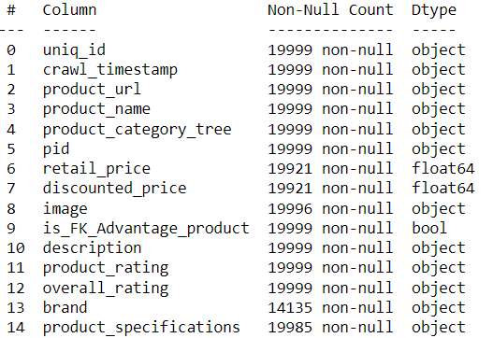
DATA DESCRIPTION

Slide 5
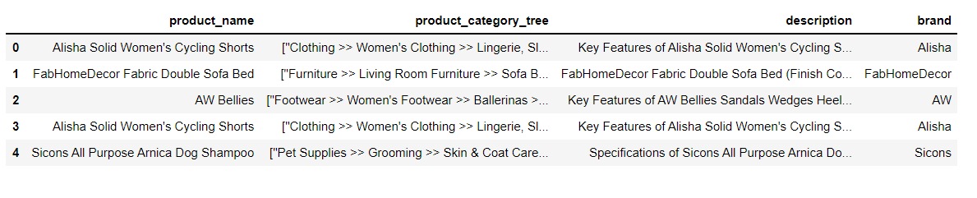
EXPLORATORY DATA ANALYSIS
Dropping the unnecessary columns

Slide 6
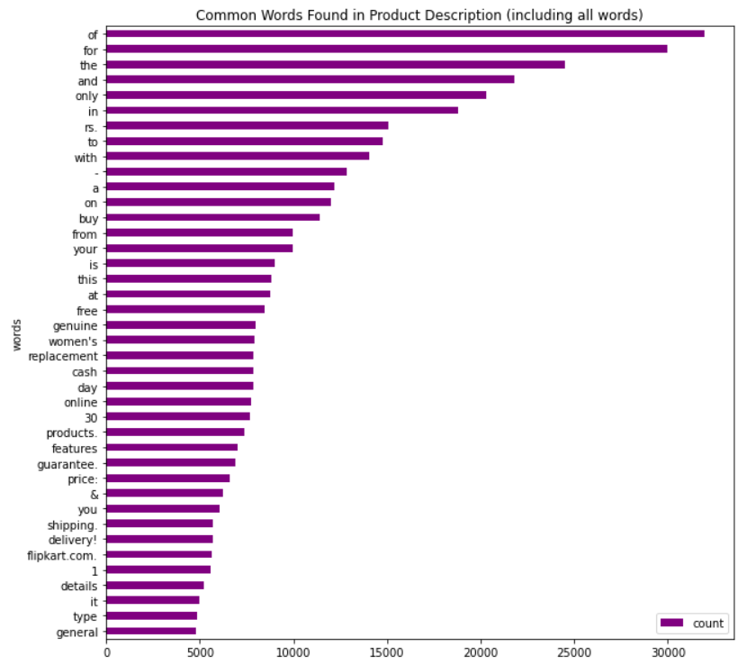
EXPLORATORY DATA ANALYSIS
Bar Graph of the most common words in Product Description
A bar graph of the 40 most frequent words occurring in the Product Description is made.

Slide 7
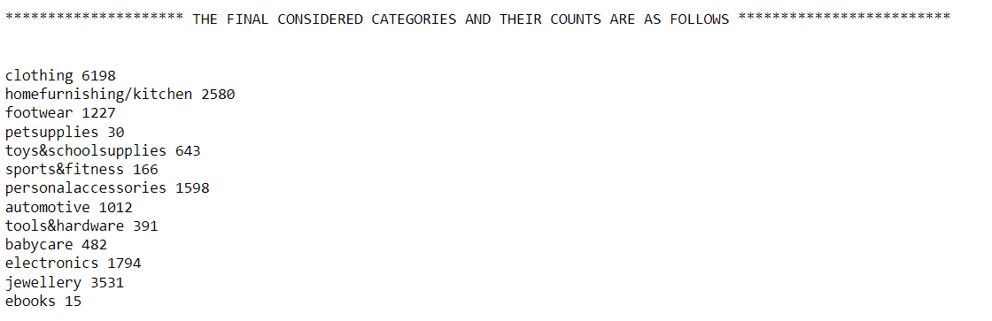
EXPLORATORY DATA ANALYSIS
Combining the redundant categories

Slide 8
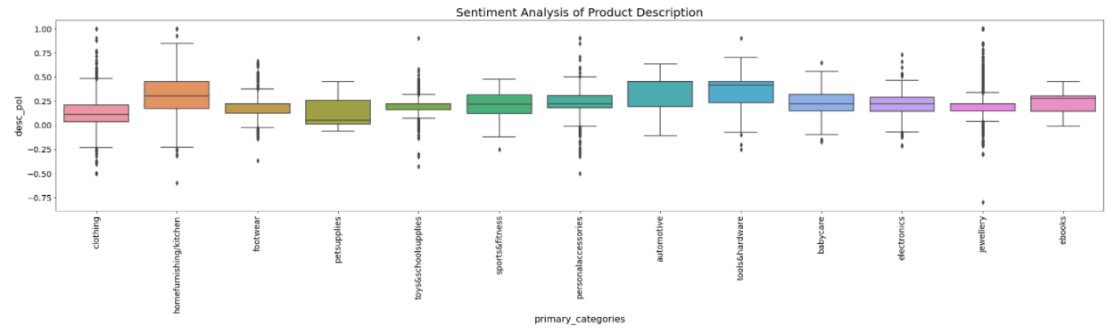
EXPLORATORY DATA ANALYSIS
Sentiment Analysis
Sentiment analysis of the Product Description corresponding to each category. This is done by measuring the polarity of each product's description.

Slide 9
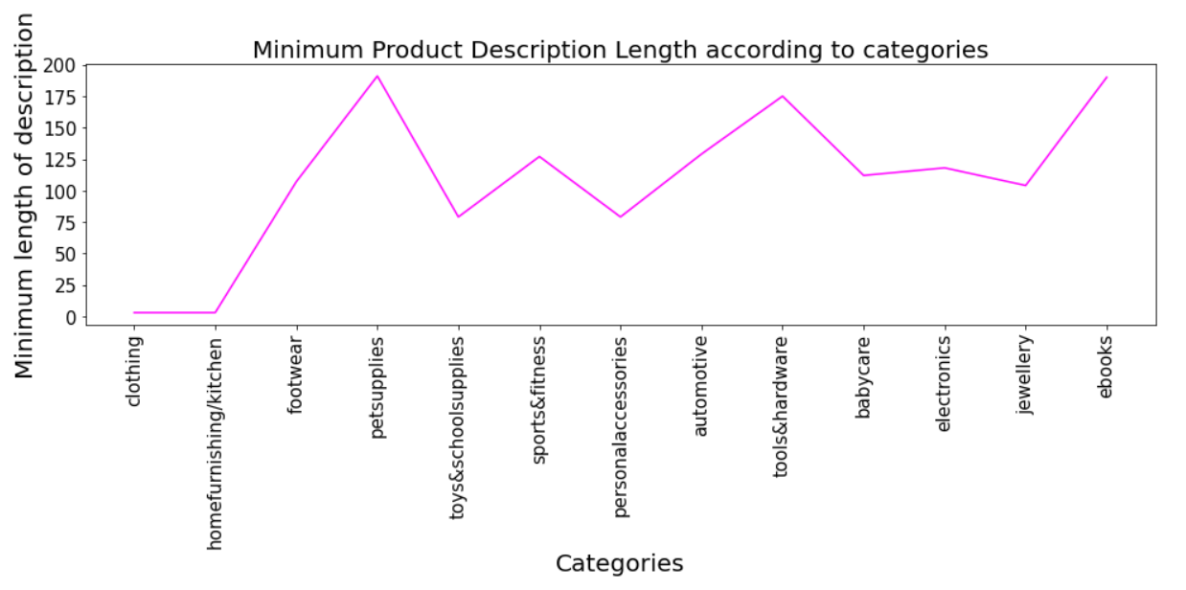
Text Length Analysis
Visualization of the Minimum description length across all the categories

Slide 10
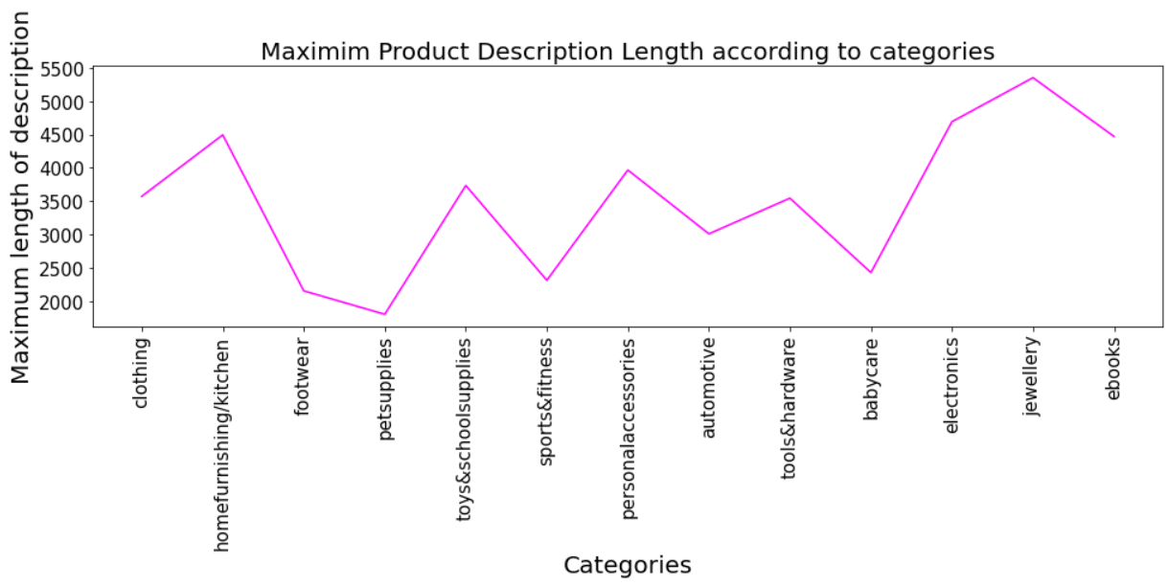
Text Length Analysis
Visualization of the Maximum description length across all the categories

Slide 11
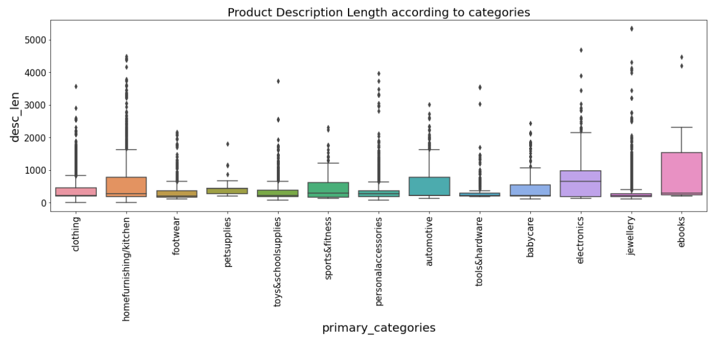
Text Length Analysis
Boxplot of the Average description length across all the categories

Slide 12
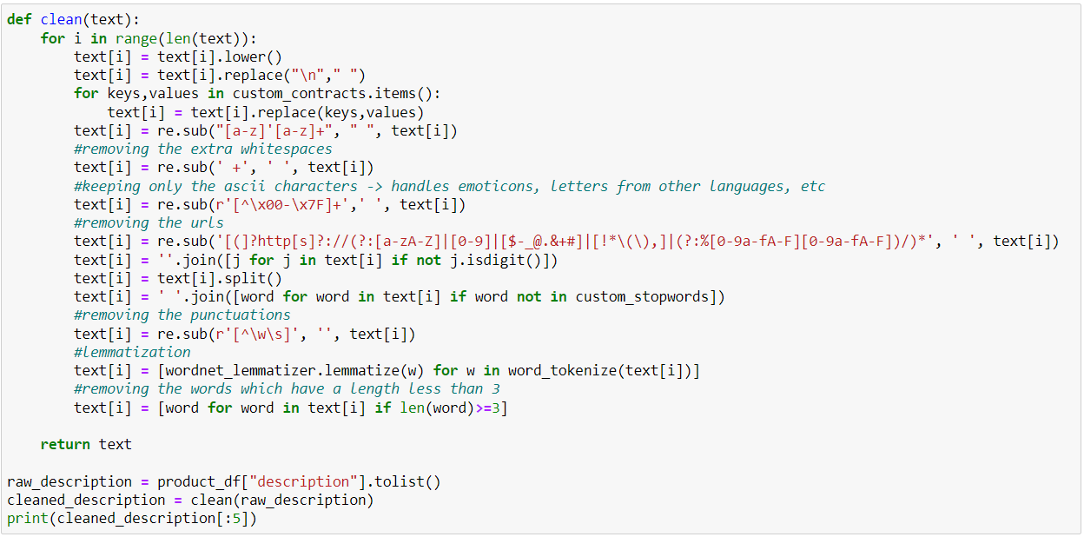
Data Cleaning and Pre-processing
Lowercasing, Custom Contraction, Mapping, Keeping only the ascii characters in the corpus, removal of URLs/ Hyperlinks, Removal of numbers and punctuations, Custom Stopword Removal Lemmatization, Removal of extra whitespaces

Slide 13
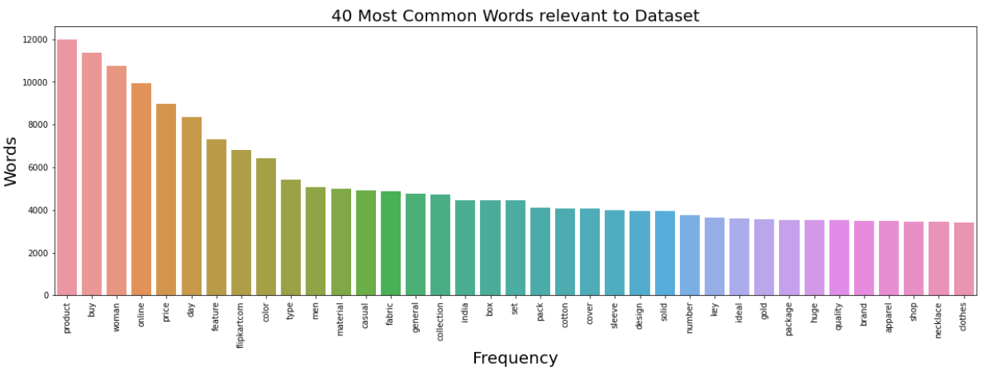
Visualization
Visualization of the most common words

Slide 14
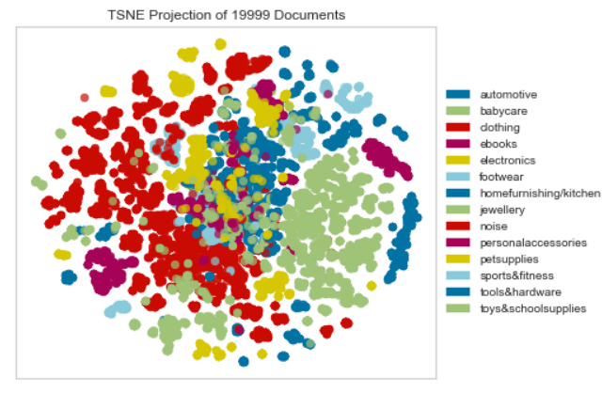
Visualization
Visualization of the Overlapping of classes using TSNE Plots

Slide 15
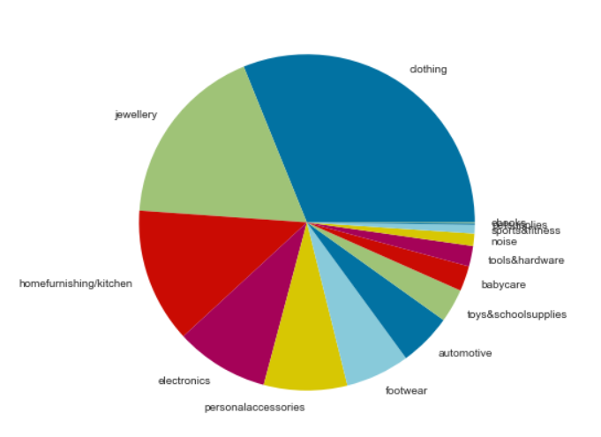
Balancing out the Dataset
Two of the following dataset balancing techniques are adopted in order to ensure that there is an almost equal frequency of products for each major product category (in order to train an unbiased model and increase the accuracy).
Over Sampling
Under Sampling

Slide 16
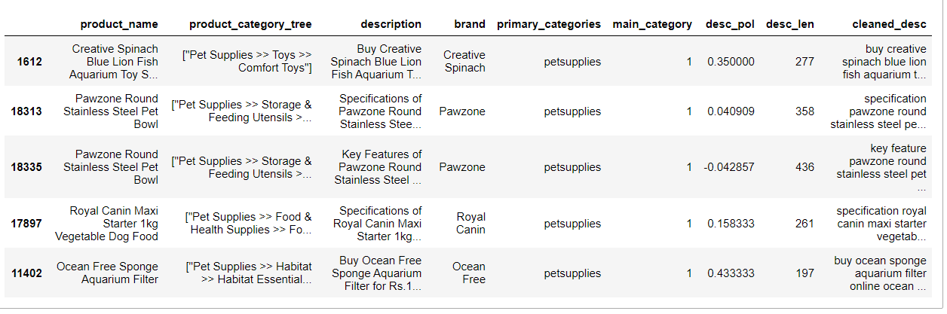
Balancing out the Dataset
Over Sampling
Random oversampling of the minority classes (i.e., classes apart from clothing and jewellery) is implemented.

Slide 17
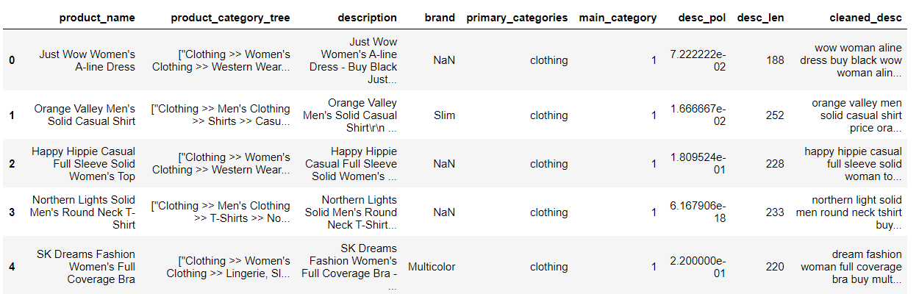
Balancing out the Dataset
Under Sampling
Random undersampling of the majority classes (i.e. clothing and jewellery) is implemented.

Slide 18
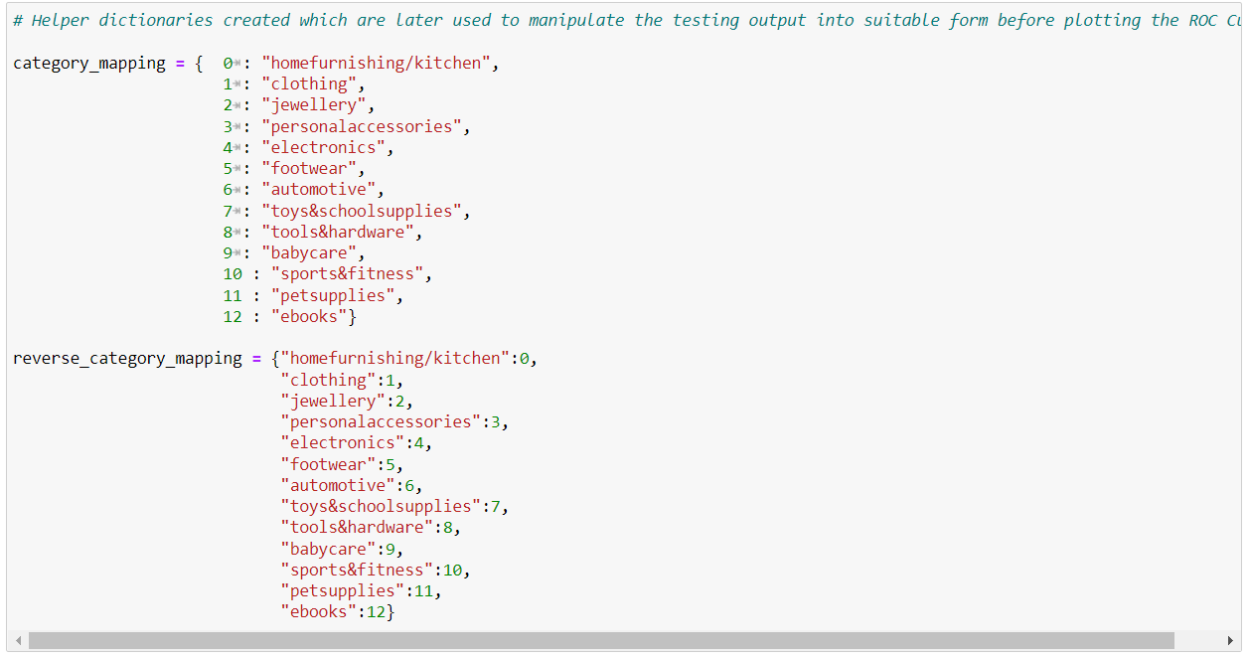
Modelling
In order to plot the ROC Curves and find the AUC score, there was a need to have a proper encoding for the 13 primary categories.

Slide 19
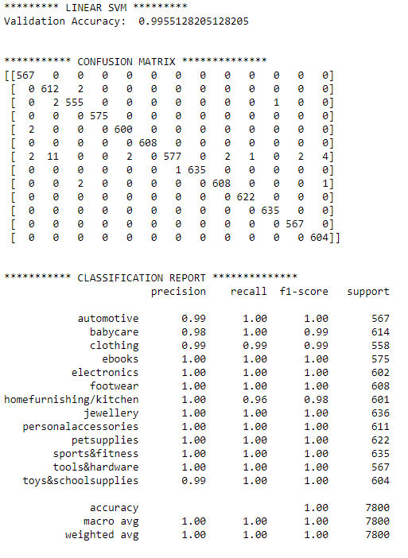
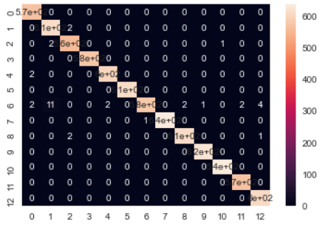
Modelling
Linear Support Vector Machine

Slide 20
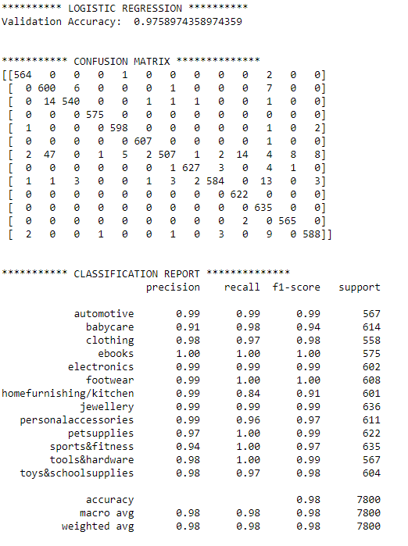
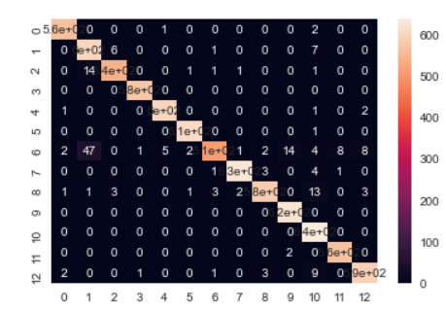
Modelling
Logistic Regression (Binary Classification Method)

Slide 21
CONCLUSION
The ROC Curves are plotted and the corresponding AUC score for each of the categories has been plotted to get an idea about the accuracy of the model.
Two Models are built with accuracy of 97 and 99.
In real world, we have can use this as a recommendation system.

Slide 22
THANK YOU….

